Slide 1

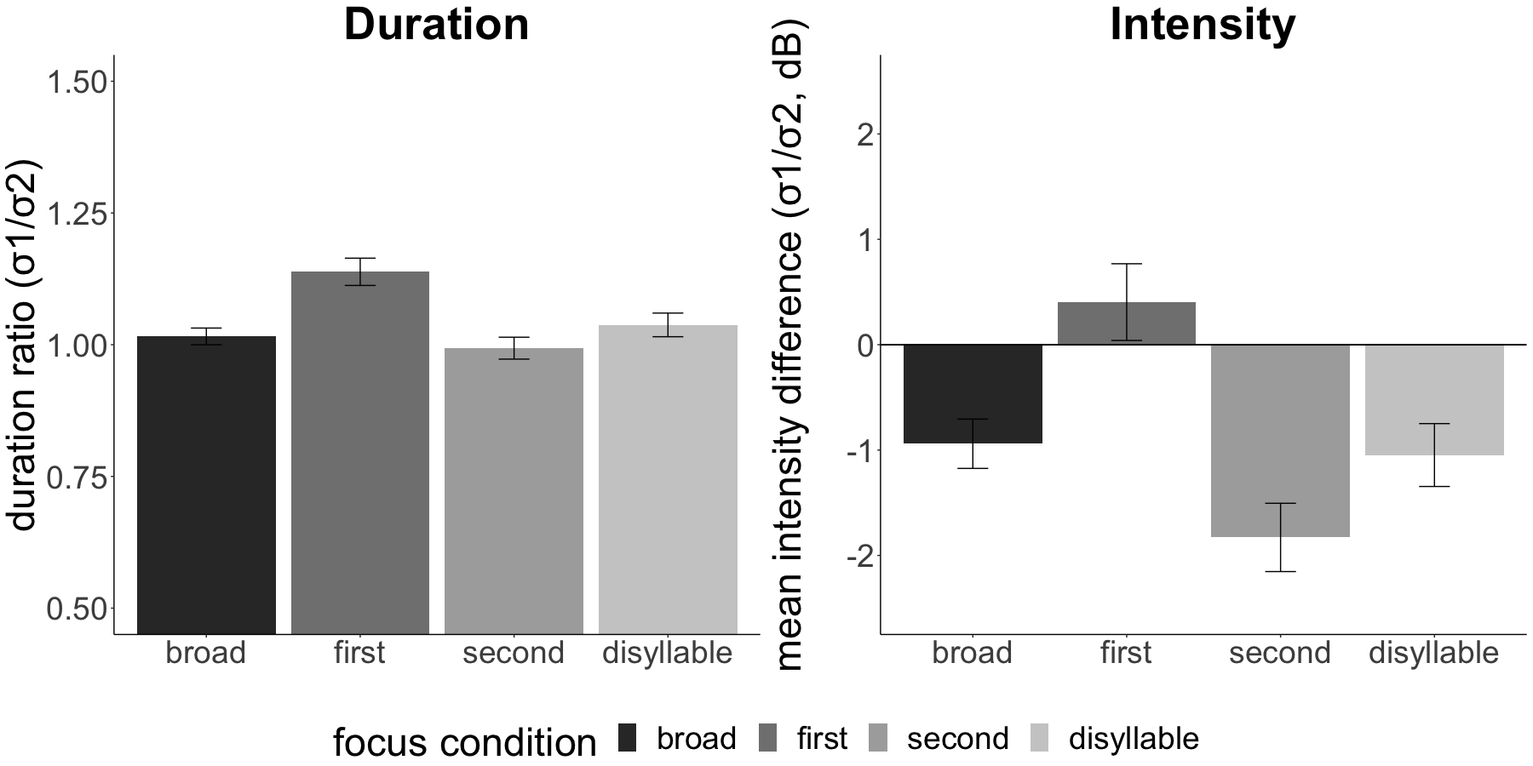
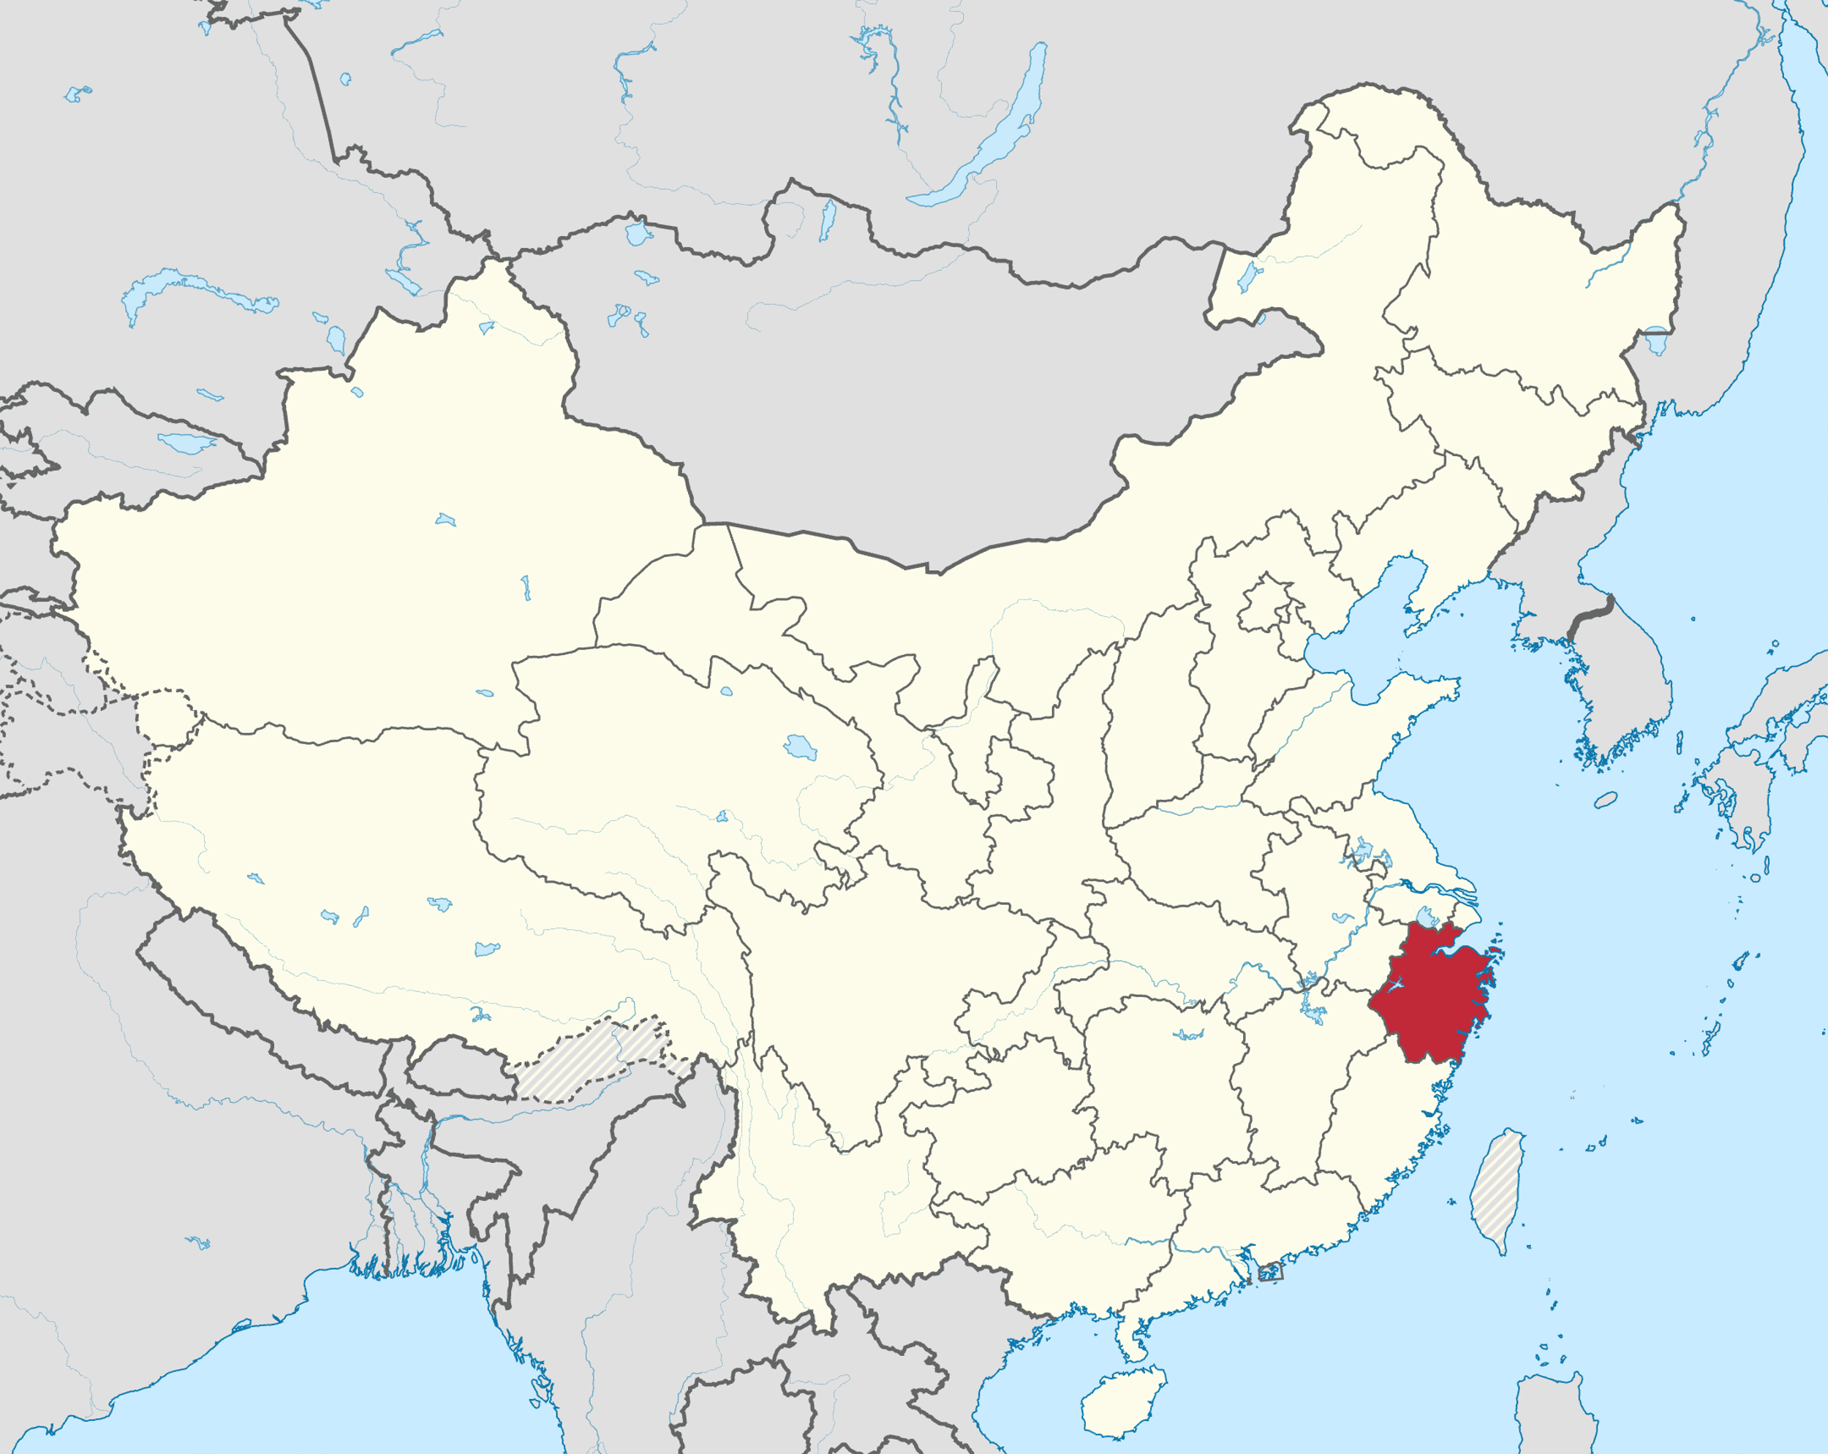
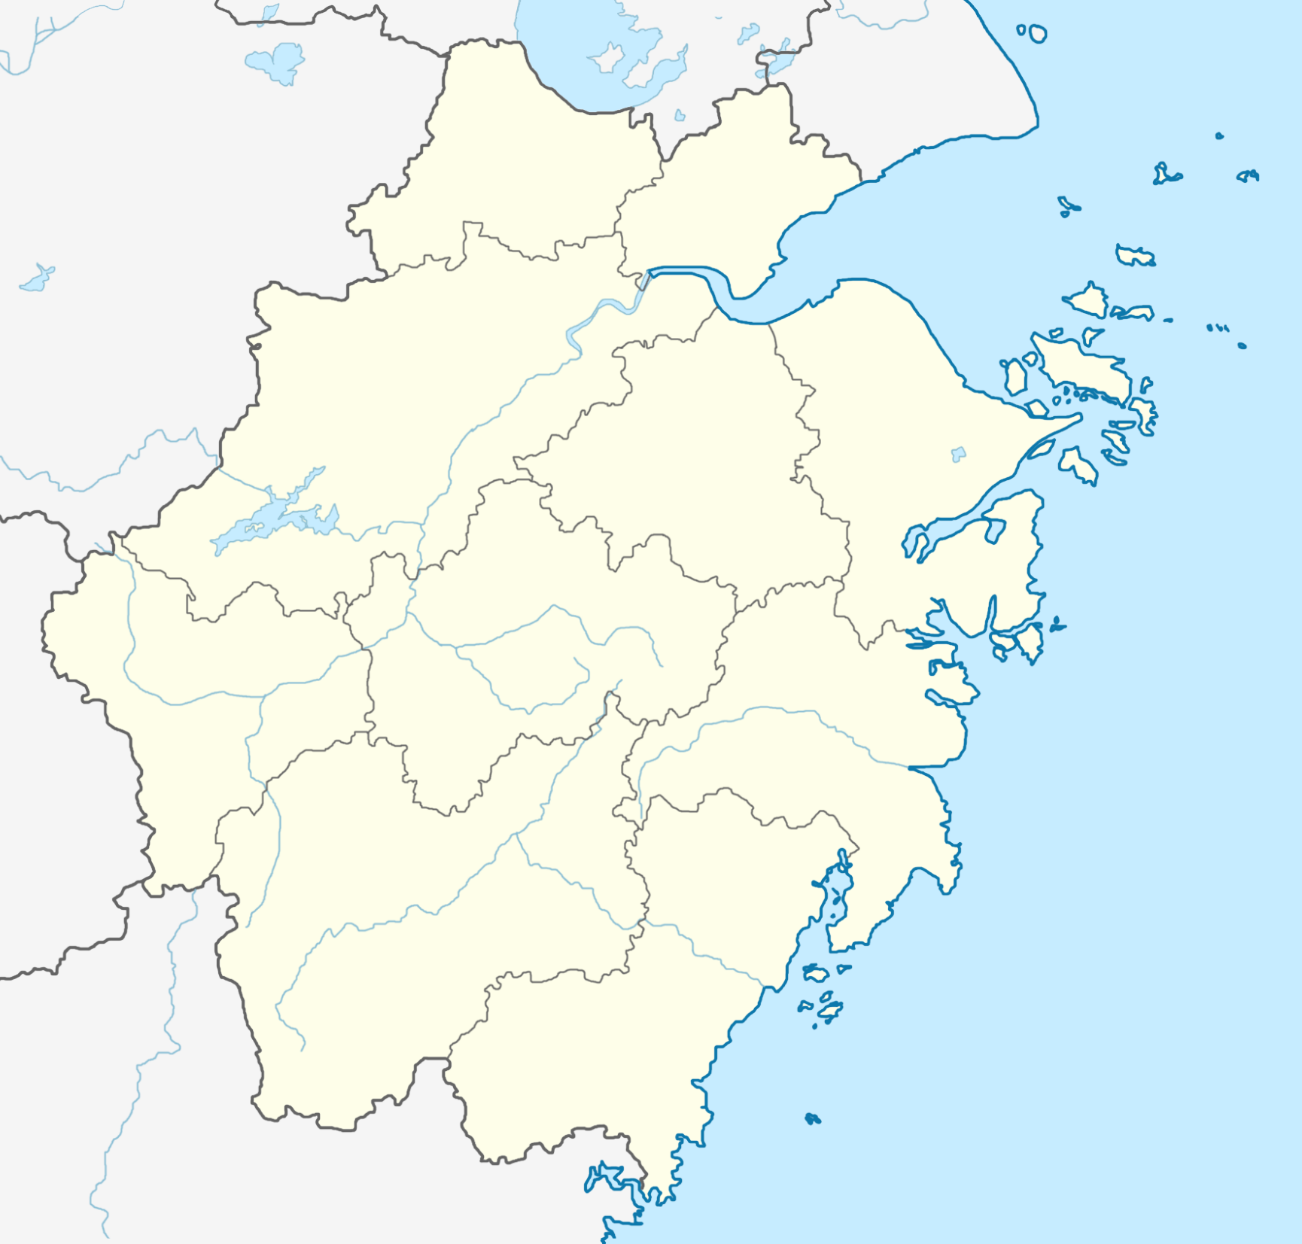


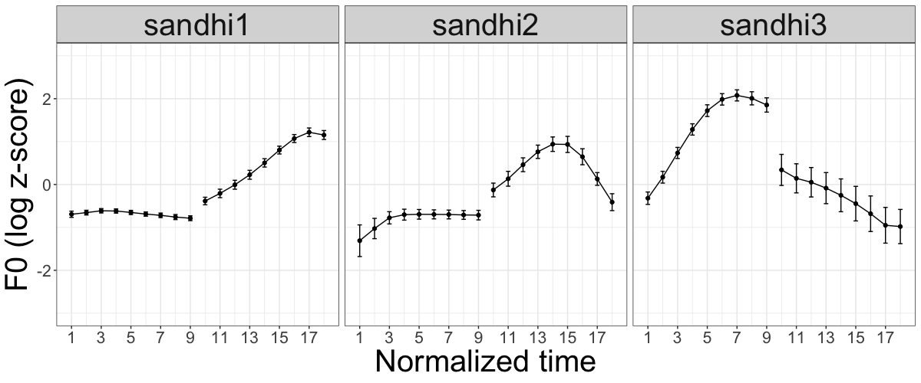
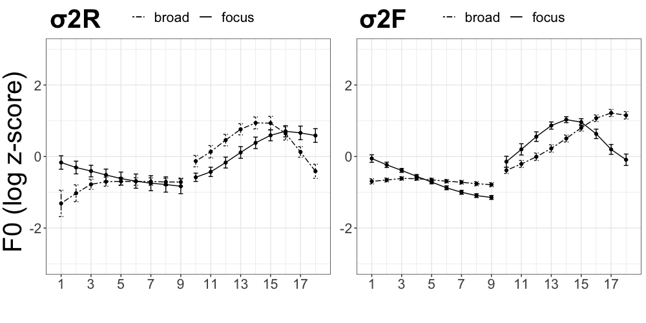

Phonetics and Phonology of Corrective Focus in Xiangshan Wu Chinese:
Interaction with disyllabic tone sandhi
Yibing Shi, Francis Nolan, Brechtje Post
Phonetics Laboratory, University of Cambridge
Introduction
Results
Prosodic focus realisations
Xiangshan Wu Chinese
Tone inventory: 6 lexical tones, 4 non-checked tones (HH, HL, LHL, LH) and 2 checked tones (Hq, LHq)^{[8]}
RQ: How is focus realised phonetically (via intensity, duration) and phonologically (via sandhi changes), and whether there is any cue-trading relation between the two?
Phonetic cues Focus elicitation paradigm
Significant increased relative duration and intensity of the focused syllable (when only one syllable is focused)
No significant differences when both syllables are focused
Phonological cues: tone sandhi patterns
Sandhi patterns under broad focus
LHL-HH/LHL/LH underlying tones: sandhi1 (78.7%)
LHL-HL underlying tones: sandhi3 (76.5%)
sandhi2: only occur 5.7% across all tokens
Sandhi patterns under corrective focus
broad sandhi on the disyllable (BS, 73%);
focus realising syllable 2 sandhi as a rise (σ₂R, 13%)
focus realising syllable 2 sandhi as a fall (σ₂F, 9.9%)
the focused syllable carrying its underlying tone (UT, 4.1%)
Interaction between the two
Comparisons of phonetic cues across different sandhi types
No significant differences in duration ratio
Significantly lower mean intensity difference for UT type
Phonetic cues (on-focal)
Phonological cues
Cross-linguistic
Increased intensity
Lengthened duration
Expanded pitch range^{[1]}
Additional prosodic boundary
Prosodic re-phrasing^{[4]}
Tonal languages
✓ Rather similar^{[2][3]}
❓
Tone sandhi domains
❓Inconsistent findings^{[5][6][7]}
Xiangshan
Zhejiang
Methodology
Participants & Materials
8 Xiangshan speakers (4 female, age range 47-53, mean age 50) * 38 disyllabic tokens (LHL-initial underlying non-checked tone combinations) * 4 focus conditions = 1,216 tokens
Focus elicitation paradigm
Broad focus: read test tokens one by one.
Corrective focus: correct a token they heard in a recording using the token presented to them.
Data analysis
Phonetic cues: linear mixed-effects models for comparisons of normalised duration ratio (σ₁/σ₂) and mean intensity differences (σ₁ – σ₂) across different focus conditions; all tokens analysed.
Phonological cues: visualisations and comparisons of tone sandhi patterns across all focus conditions; only lexical compounds & Modifier-Head phrases analysed.
Interaction between the two: linear mixed-effects models
Focus | Recording | Desired output
σ₁ | These words are CB. | No, they are AB.
σ₂ | These words are AD. | No, they are AB.
σ₁σ₂ | These words are EF. | No, they are AB.
Focus | UR tones | Broad sandhi | Focus sandhi
σ₁ | LHL-HL | LH-ML | LHL-ML
σ₁ | LHL-H | L-LH | LHL-LH
σ₂ | LHL-HL | LH-ML | L-HL
σ₂ | LHL-H | L-LH | L-H
Discussion
Phonetic cues: focus induces a higher relative intensity and lengthened duration on the focused syllable; not too much change of relative intensity or duration when focus is on the whole disyllable.
Phonological cues: Tone sandhi patterns can be realised differently under corrective focus, and in some cases focus potentially blocks the sandhi for the focused syllable while having no effect on the sandhi of the non-focused syllable.
Interaction between the two: a potential cue-trading relation between sandhi and gradient acoustic cues
References: [1] W. E. Cooper, S. J. Eady, & P. R. Mueller (1985) J. Acoust. Soc. Am. [2] Y. Chen (2006) J. Phon. [3] Y. Chen & C. Gussenhoven (2008) J. Phon. [4] S. -A. Jun & H. -J. Lee (1998) in 5th International Conference on Spoken Language Processing (ICSLP 1998). [5] B. Ling & J. Liang (2019) Lingua. [6] M. Y. Chen, (2000) Tone Sandhi: Patterns across Chinese Dialects. [7] J. Tian & J. Kuang (2020) in Speech Prosody 2020. [8] Y. Shi (2020) Tones and Disyllabic Tone Sandhi in Xiangshan Chinese Dialect.

